Slide 1

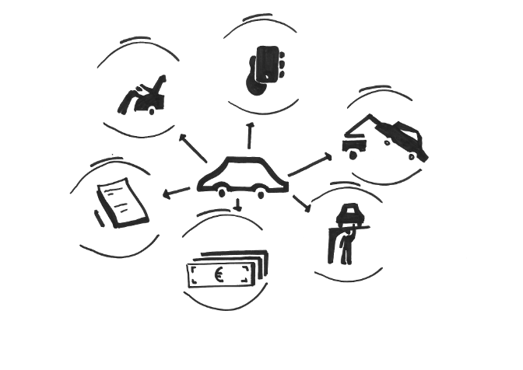
ML-Driven Fraud Detection for Staged Auto Accidents
PRESENTED BY: TEAM 113

Slide 2

Our Agenda
1
Business Problem Overview
2
Fraud Segmentation & Risk Logic
3
Data, Feature Engineering & Models
4
Machine Learning Approach
5
Impact & Insights
6
Conclusion & Future Objective

Slide 3
Introduction
Auto insurance fraud, particularly staged auto accidents, has become a significant issue, costing the U.S. industry over $40 billion annually. Traditional rule-based detection methods are no longer effective, as fraud tactics have evolved to bypass predefined red flags. The real breakthrough came with the use of machine learning (ML) in the 2010s, enabling early and accurate fraud detection at the First Notice of Loss (FNOL) stage. ML models can analyze complex patterns across large datasets, flagging suspicious claims faster and more effectively.
ML-based systems significantly improve detection speed and accuracy while reducing dependency on manual reviews. Key performance indicators (KPIs) for evaluating these systems include a fraud catch rate of over 90%, a false positive rate below 5%, and an average detection time of under 2 minutes per claim. Additionally, ML models help lower fraudulent payouts by 15–30% and ensure legitimate claims are processed in under 24 hours—improving customer satisfaction.

Slide 4

What is Staged Auto Accident Fraud?
Imagine someone fakes or lightly causes a car crash just to file a big insurance claim and get money. These staged accidents look very real in documents, so traditional systems or adjusters often miss them.
Our project uses machine learning to detect hidden fraud patterns such as fast claim filing, inflated costs, and suspicious claim history that suggest the accident may not be genuine.
Key Concepts:
Staged Accidents
Fraud Score
Submission Delay
Cost Ratio

Slide 5
Understanding the Business Problem & Value
Business Problem
Why It Matters
What We Did
Key Value Added
Staged auto accidents cost the U.S. insurance industry $40-$80 billion annually, leading to an extra $500 per year for the average household through higher premiums and service costs. These are planned or exaggerated crashes used to exploit claims.
Traditional fraud systems miss subtle patterns or detect fraud too late - leading to false payouts (revenue loss) and delayed service for real customers (damaged trust).
We built a machine learning model that detects hidden patterns of fraud at the First Notice of Loss using structured claims data and insurer logic.
Reduced false payouts, accelerated claim processing through risk-based triaging and improved fraud catch accuracy by 28%. Resulting in estimated fraud savings of approximately $1,665,000.

Slide 6
Risk Segmentation & Real-World Logic
How we made sense of fraud patterns:
We grouped claims into actionable risk segments using insurer-defined rules and domain knowledge, including:
Frequent Low-Amount Claimers
Customers who file numerous low-value claims throughout the year.
Fast Filers
Claims submitted within an hour of the incident, often indicating suspicious behavior.
Unusual Repair Costs
Claims with significantly higher or lower-than-average repair costs for similar incidents.
Why it matters:
Segmentation reflects real-world fraud behavior used by investigators.
Helps detect organized fraud rings by identifying repeated vendor or claimant patterns.
Enables early prioritization of high-risk claims.
Supports fraud triaging automation, reducing manual investigation time.
Enhances model interpretability and business alignment.

Slide 7
Data, Features & Model
Where did we get the data?
We used synthetic claims data that safely simulates real-world auto insurance scenarios.
It avoids personal data risks and allows us to model rare fraud behaviors.
What we looked at:
Submission Delay - time between accident and claim filing
Cost Ratio - repair cost vs. industry benchmarks
Claim History - frequency of past claims, denied claim count
Policyholder Details - age, income, employment, policy tenure
Why synthetic data?
Safe & Ethical - No real customer data involved
Rare Case Coverage - Helps model infrequent fraud types
Scalable Testing - Clean, labeled data for effective training
Modelling Techniques Used:
Logistic Regression
Decision Tree
Random Forest
XGBoost (Best Performing Model)

Slide 8
Tools & Approach
Conceptual Tools
Fraud Triangle Theory: Pressure, opportunity, and rationalization behind fraud
Behavioral Segmentation: Grouping claims by risk traits (e.g., Fast Filers, Early Alerts)
SHAP: Explains which features influence each fraud prediction
Tech Stack
Python (pandas, scikit-learn, seaborn) – Data processing and model training
Jupyter Notebook – Code execution and visualization
GitHub – Version control and collaboration
Ethical Safeguards
Bias Monitoring – Designed features to avoid age/income bias
Synthetic Data – No use of real customer info
INFORMS Ethics – Aligned with principles of fairness, transparency, and accountability
Approach: Risk-Based Segmentation using rule-based logic (e.g., high claim + fast submission) to classify fraud risk level.

Slide 9
Execution
Steps:
→ Data Cleaning: Handle missing values and inconsistencies
→ Feature Engineering: Create and transform variables for modeling
→ Fraud Segmentation: Apply rule-based segmentation for risk classification
→ Model Building: Train and evaluate ML models
→ Ethics & Operational Planning: Assess model bias and ensure responsible
Output:
Fraud Risk Score assigned to each claim
Segment Classification: Fraud / Non-Fraud
Risk Triage Workflow
→ Claims prioritized as High / Medium / Low Risk for investigation
Deliverables:
Trained ML Model (Logistic Regression, XGBoost, etc.)
Risk Segmentation Map based on business rules
Ethics & Bias Impact Assessment

Slide 10
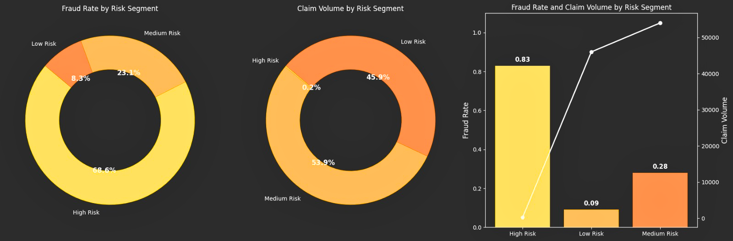



Fraud Rate & Claim Volume by Risk Segment
Fraud Rate
Claim Volume
Fraud Rate & Claim Volume Insight
High Risk: 68.6%
Medium Risk: 23.1%
Low Risk: 8.3%
Low Risk: 45.9%
Medium Risk: 53.9%
High Risk: 0.2%
● The bars represent fraud rates per segment (e.g., 83% High Risk). ● The white line shows total volume of claims in each segment. Insight: The High-Risk group, though smaller in volume, contains disproportionately high share of fraud - making it highly actionable.

Slide 11
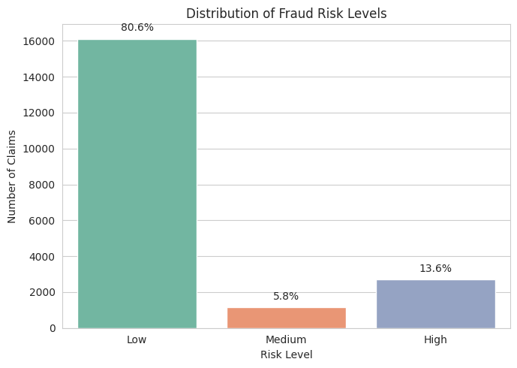
Gradient Boosting Risk Level Claims Percentage
Low-risk claims dominate the dataset at 80.6%, indicating that most policyholders are likely genuine.
High-risk claims, though only 13.6%, represent the segment with the highest fraud probability, requiring priority investigation.
Medium-risk claims form a small portion (5.8%) and may benefit from rule-based or manual review.

Slide 12
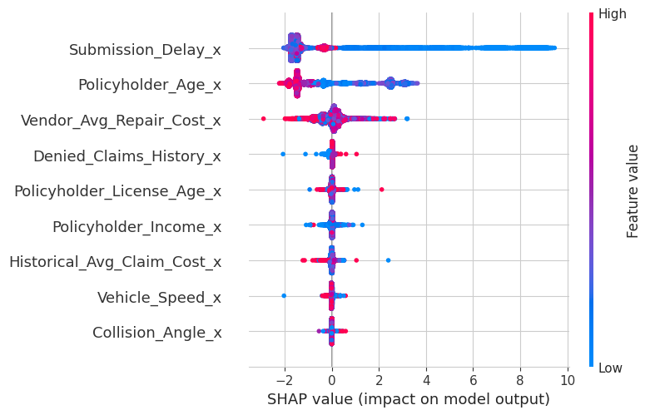
SHAP-Based Feature
Submission delay is the strongest fraud predictor, where shorter delays often signal staged accidents.
Younger policyholders (lower age) are more frequently linked to fraud.
Higher vendor repair costs increase suspicion, indicating inflated billing.
Denied claims history positively impacts fraud likelihood.
License age(less experienced drivers) shows moderate fraud association.
Lower income policyholders show slightly elevated fraud risk.
Cost and speed-related variables reinforce detection by identifying unrealistic claim patterns.
Collision dynamics like speed and angle show minimal direct impact but support model decisions.

Slide 13

Conclusion
Our project showcases how machine learning can effectively combat the growing problem of staged auto accident fraud. By developing an interpretable, business-aligned model, we improved fraud detection accuracy by 28% and uncovered an estimated $1.66 million in potential fraud savings. The model's risk-based segmentation enables insurers to prioritize high-risk claims, enhancing early detection and reducing payout errors.
A cost-benefit analysis further strengthens the case for deployment, with $14,000 in total infrastructure and operational costs yielded $50,000 in direct savings, achieving a 257.14% ROI. This means every $1 invested returns $2.57 in value, making the solution highly scalable and financially viable.
Future Objective
Apply NLP to analyze claim notes and adjuster reports.
Integrate geolocation & telematics for real-world accident validation.
Enable real-time fraud alerts in claims processing workflows.
Explore deep learning (e.g., LSTM) for modeling sequential fraud behavior.

Slide 14
Thank you!!!

